Slide 1



Entity Linking WPI-Basis Technology Project
Sept 2020-Dec 2020
Team members: Kratika Agrawal, Vandana Anand, Xinlu He, Min Huang, Soumya Joshi, Jing Yu Basis Technology Mentors: Gil Irizarry, Kfir Bar, Lital Ravid, Karin Lin, Zachary Yocum
WPI Mentors: Prof. Chun-Kit Ngan, Prof. Fatemeh Emdad

Slide 2






Project Team Introduction:
Sponsors & Mentors
Gil Irizarry Kfir Bar
Vice President - Engineering Chief Scientist
gil@basistech.com kfir@basistech.com
Team Members
Vandana Anand vanand@wpi.edu 978-427-5212 | Kratika Agrawal kagrawal@wpi.edu 774-701-9288 | Jing Yu jyu5@wpi.edu 608-886-8578 | Soumya Joshi sjoshi2@wpi.edu 508-615-8354 | Min Huang mhuang3@wpi.edu 774-253-5410 | Xinlu He xhe4@wpi.edu 774-253-8221

Slide 3

Project Goal
Goal: Improve BT’s current entity linking tool Rosette by applying a novel model to increase entity linking performance.

Slide 4

Latent Relations Paper

Slide 5
Research Problems Addressed
Tackled candidate selection problem which is to choose best entity from a list of candidates by
local and global modeling
Innovatively including latent relations between mentions into the global model
Eliminated the need for extensive feature engineering by using representation learning to learn relation embeddings
Notes:
Written from abstract as well the contribution part of the paper

Slide 6
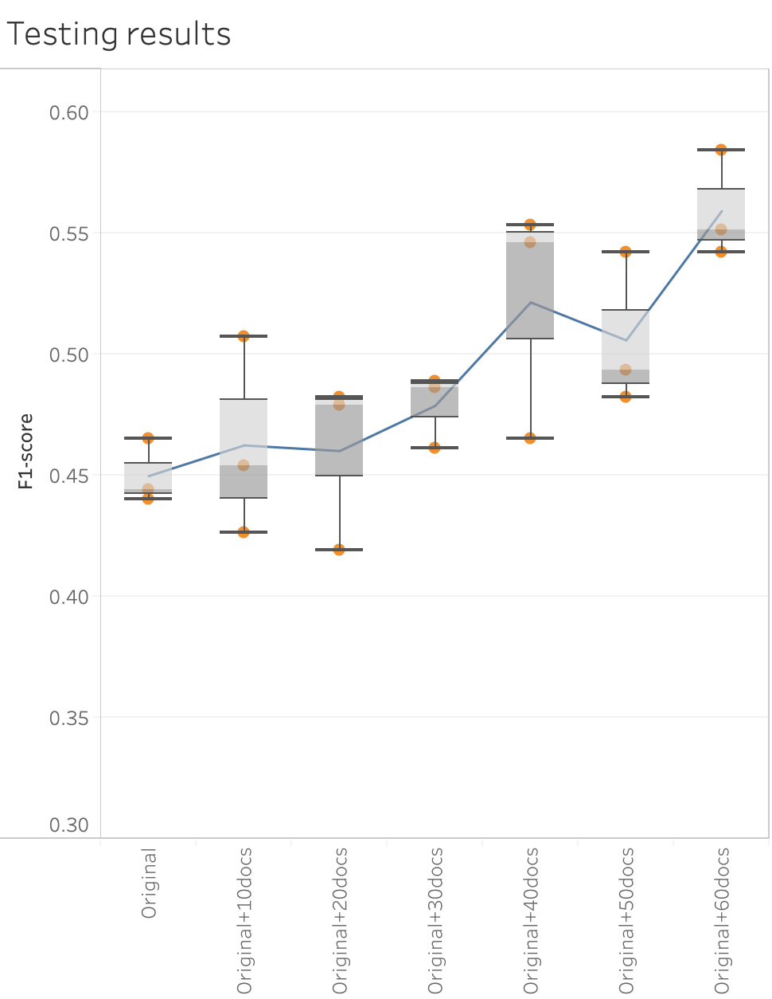
Conclusion
Successfully applied BT dataset into the latent relations model
Better F1 score with larger BT dataset
Notes:
Written from abstract as well the contribution part of the paper

Slide 7
End2End Model

Slide 8
Model Approach
Main idea:
mutual dependency between Mention Detection and Entity Disambiguation.
Candidate: ❌ for the result of Mention Detection
✅ for all possible spans
Model Construction:
Global score and local score.
Word2Vec
Bi-direction LSTM
Notes:
emphasize the importance of the mutual dependency between Mention Detection and Entity Disambiguation.
Candidates are not only generated for, for all possible spans in the text
In the model,
Use both, to choose one entity from the candidate group
Use the pre-trained word embeddings of the Word2Vec model
Use Bi-direction LSTM to include lexical and context information in the local model.

Slide 9
Results - AIDA Dataset
Entity Disambiguation | Train Score | Test Score | Test Precision | Test Recall
Best Scores | 92.2% | 85.7% | 88.5% | 83%
Entity Linking | Train Score | Test Score | Test Precision | Test Recall
Best Scores | 62.9% | 56.8% | 57.5% | 56.1%
Using all Spans Best Score | 89.1% | 80.1% | 83.5% | 76.9%
Notes:
We trained and tested the AIDA data to see what accuracy we could expect for the model. ED performed a lot better than EL overall. The entity linking scores are very similar to the final latent relations model accuracy, around 55% showing promising results. We do expect to see similar or lower scores for the BT dataset when we test that in the future because it is a smaller dataset with around 3000 mentions whereas the AIDA dataset has more than 502K mentions.

Slide 10
Novel Approach
with
Robust Disambiguation

Slide 11
Model Approach
Prior Probability Score
Robust Disambiguation
Context-based Similarity Score
Generate Graph
Coherence Among Entities

Slide 12
Novel Disambiguation Approach
Robust Disambiguation
Words Embeddings
Novel Disambiguation
Convolution Neural Network

Slide 13
Thank You!

